Slide 1

CSE438 Paper Presentation
Topic- High Performance Lithography Hotspot Detection with Successively Refined Pattern Identifications and Machine Learning
Name- Zaki Habib
Id- 19201073
Section- 01

Slide 2
Introduction What is Lithography?
Lithography is a process used to create patterns on the surface of a substrate.
It is used in Semiconductor manufacturing, Micro-electronics and Printing.
Process
A mask with pattern is placed on the wafer.
Light is shone and used to create the pattern on the wafer.

Slide 3
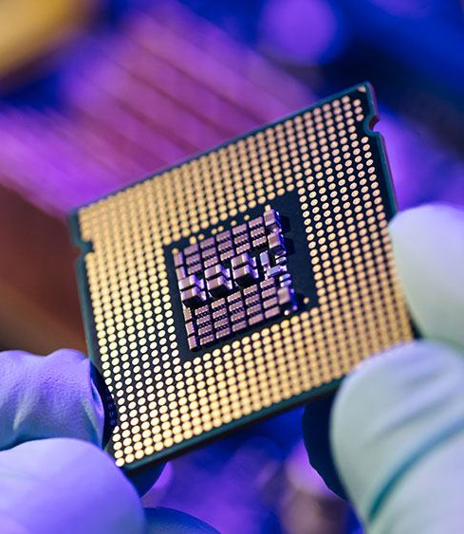
Lithography Hotspot
A lithography hotspot is a region in a semiconductor chip design that is susceptible to manufacturing defects due to the difficulty of patterning the layout in that region.

Slide 4
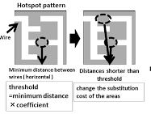
Hotspots can be created by a variety of factors, including:
Small feature sizes: As feature sizes in semiconductor chips continue to shrink, it becomes more difficult to pattern these features accurately with lithography. This can lead to hotspots where the features are not printed correctly, resulting in defects.
Complex geometries: Complex geometries can also be difficult to pattern accurately with lithography. This is because the light used in lithography is diffracted by sharp corners and edges, which can cause the features to be printed incorrectly.
Near-critical dimension (NCD) features: NCD features are features that are close to the limit of what can be patterned accurately with lithography. These features are more susceptible to manufacturing defects than larger features.
Mask defects: Mask defects can also cause hotspots. Mask defects are imperfections in the mask that is used to pattern the chip. These defects can cause the features on the chip to be printed incorrectly, resulting in hotspots.

Slide 5
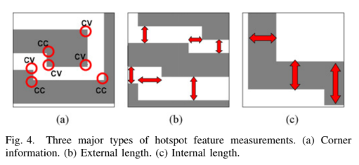

Slide 6
Lithography Hotspot Detection Issues
The paper "High Performance Lithography Hotspot Detection with Successively Refined Pattern Identifications and Machine Learning" by Duo Ding, J. Andres Torres, and David Z. Pan, Senior Member, IEEE, discusses the problems with lithography hotspot detection.
The authors of the paper identify the following problems with lithography hotspot detection:
The number of possible hotspot patterns is vast. There are a very large number of possible hotspot patterns that can occur in a chip design. This makes it difficult to develop a comprehensive list of hotspot patterns that can be used for detection.
Hotspot patterns can be difficult to identify. Hotspot patterns can be difficult to identify because they can be small, have complex geometries, or be hidden by other features in the chip design.
Hotspot detection can be computationally expensive. Lithography hotspot detection can be computationally expensive, especially for large chip designs. This can make it difficult to perform hotspot detection in real time.

Slide 7
High Performance Lithography Hotspot Detection
The paper proposes a two-step approach to hotspot detection that uses Calibration to establish set of hotspot identifiers followed by a Detection step that analyzes pattern and uses ANN to to identify the issues.
The paper's method achieves high accuracy and low false alarm rate, and it is able to address some of the challenges of lithography hotspot detection.

Slide 8
High Performance Lithography Hotspot Detection
Paper's 2 Step approach to hotspot detection:
Calibration and Layout Analysis
Detection
Pattern matching: The first step identifies potential hotspot patterns using a combination of pattern matching and machine learning techniques. Pattern matching is a fast and efficient way to identify hotspot patterns, but it is not always accurate. Machine learning is more accurate than pattern matching, but it can be more computationally expensive.
Machine learning: The second step uses machine learning to identify hotspot patterns that are not explicitly enumerated in a pattern matching database. This helps to address the challenge of the vast number of possible hotspot patterns.

Slide 9
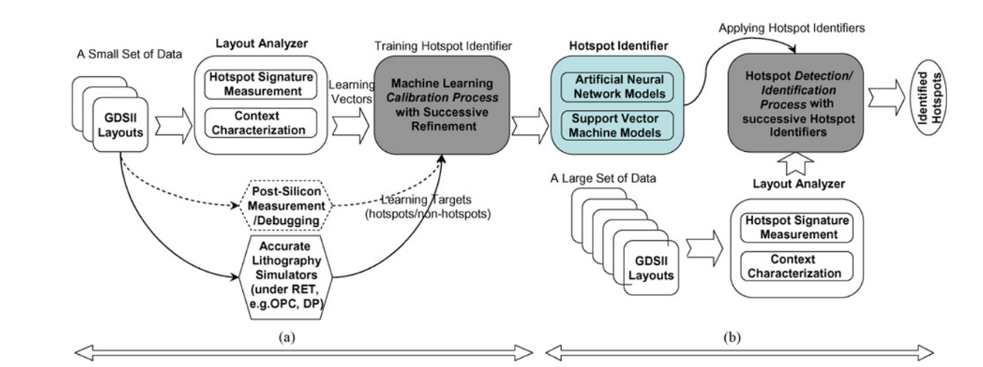

Slide 10
Calibration and Layout Analysis
The calibration stage involves:
A relatively small set of layouts for configuring the hotspot identifiers via supervised learning techniques;
A layout analyzer for characterizing layout geometries;
A lithography simulator (or post-silicon measurement) to provide accurate information of the real hotspots as learning targets;
A novel calibration process for the training and validation of hotspot identifier models via successive refinements.

Slide 11
Pattern matching:
Pattern matching is a simple and efficient technique for identifying hotspot patterns.
It works by comparing the layout of a chip to a database of known hotspot patterns.
If a match is found, then the region is flagged as a hotspot. Pattern matching is fast because it does not require any complex calculations.
However, pattern matching is not always accurate because it can only identify hotspot patterns that are explicitly enumerated in the database.

Slide 12
Machine Learning
Two types of machine learning models were trained to aid in identifying hotspots, these models being ANN (Artificial Neural Network) and SVM (Support Vector Machine).
These machine learning models were used in mainly 2 aspects; first, robustness and accuracy in the weight update process, and second, detection threshold (·) optimizations for simultaneous Hhit improvement and Hextra suppression.
Both models hold their own advantages, however in practice they perform similarly to each other.

Slide 13
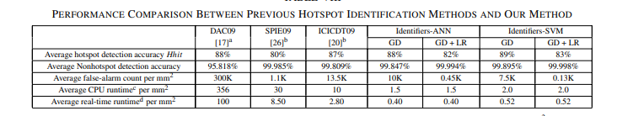
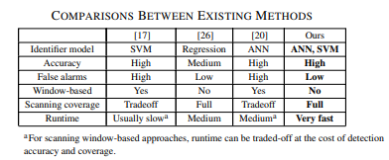
Performance Comparison

Slide 14
Results-
ANN models result in faster runtime than SVM models while SVM models outperform ANN models in both hotspot and non-hotspot detection accuracy.
Detection noise is very low which results in very low false alarms

Slide 15
Conclusion-
Fast and High Fidelity Hotspot Detection than previous and currently used hotspots simulators
The Model shows high prediction generality for hotspot patterns

Slide 16



Original Authors of the Paper-
David Z. Pan
Duo Ding
J. Andres Torres
Paper Source- High Performance Lithography Hotspot Detection With Successively Refined Pattern Identifications and Machine Learning | IEEE Journals & Magazine | IEEE Xplore

